Slide 1

Module 1
Why have Active Design and what is it?
Understand what Active Design is and the importance it has in promoting physical activity and creating healthy placemaking.
Notes:
This module introduces Active Design. The objective for this module is to understand the importance of Active Design in promoting physical activity and creating healthy placemaking and what Active Design is.
This session is based off the guidance contained within Sport England’s document “Active Design” which will be appended in the resources for further reading.

Slide 2
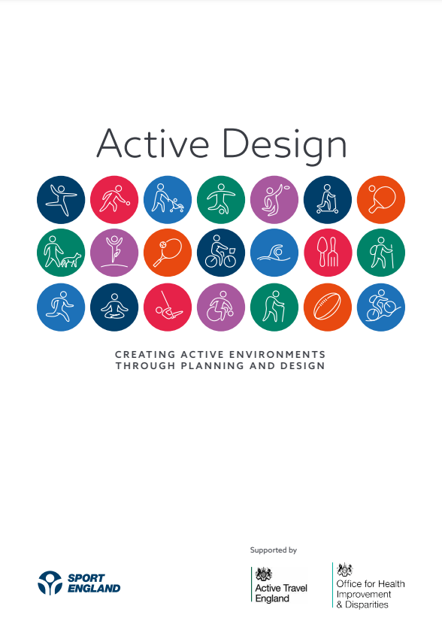
What is Active Design and why have it?
Our local environment can play an important part in encouraging us to be active.
Active Design sets out how the design of environments can help people to lead more physically active lives.
It focuses on the creation of spaces and places that support and encourage people to move more helping those involved in designing spaces to create active environments.
Notes:
Active Design sets out how the design of environments can help people to lead more physically active and healthy lives.
Where we live, work, travel and play has a major role in shaping our activity choices and Active Design aims to do this by creating places and spaces which encourage people to move more.
In May 2023 Sport England, supported by Active Travel England and the Office for Health Improvement & Disparities, released the latest version of their Active Design guidance.
This has been produced to help those involved in designing and adapting local neighbourhoods to create active environments as well as supporting people to get more active.

Slide 3
Physical activity levels
Inactive
Fairly active
Active
Less than 30
30-149
150+
minutes a week
minutes a week
minutes a week
25.5%
11.2%
25.1%
63.7%
Of people (11.8m) did less than 30 minutes a week
Of people (5.3m) were fairly active but didn’t reach 150 minutes a week
Of people (30m) did 150 minutes or more a week
(Active Lives Nov 23-24)
Notes:
Whilst nearly 64% of adults in England are active every week, there are still 25% of people doing less than 30 minutes of physical activity per week, with an additional 11% not meeting the 150 minutes recommended by the chief medical officer (Active Lives Survey, Nov 23/24 Adult Survey).
Inactivity affects groups unequally, with women, people from ethnically diverse communities, people living in more deprived areas, people with disabilities, and people with long-term health conditions less likely to be active.

Slide 4

Impact of physical activity on our health
Physical inactivity is a leading cause of many non-communicable diseases such as heart disease, diabetes, cancer and lung illnesses.
Inactivity is associated with 1 in 6 deaths in the UK and is estimated to cost £7.4 billion annually. (OHID, 2022)
Chris Whitty: "If you look back over the last 150 years, more has been done for public health by proper planning than almost any other intervention except perhaps vaccination." (TCPA Conference November 2022)​
(OHID, 2022)
Notes:
The importance of this relates to the multiple physical and mental health benefits physical activity gives people, whereas inactivity increases the risk of developing chronic health conditions. For example, physical activity reduces risk of dementia by up to 30% and cardiovascular disease by up to 35%.
In the UK there is a great urgency to help promote physical activity as a lack of physical activity is associated with 1 in 6 deaths and is estimated to cost the UK £7.4 billion annually (UK Government, OHID).
The built environment makes an important contribution to public health. As Chris Whitty put it at the TCPA 2022 Conference -“If you look back over the last 150 years, more has been done for public health by proper planning than almost any other intervention except perhaps vaccination’

Slide 5
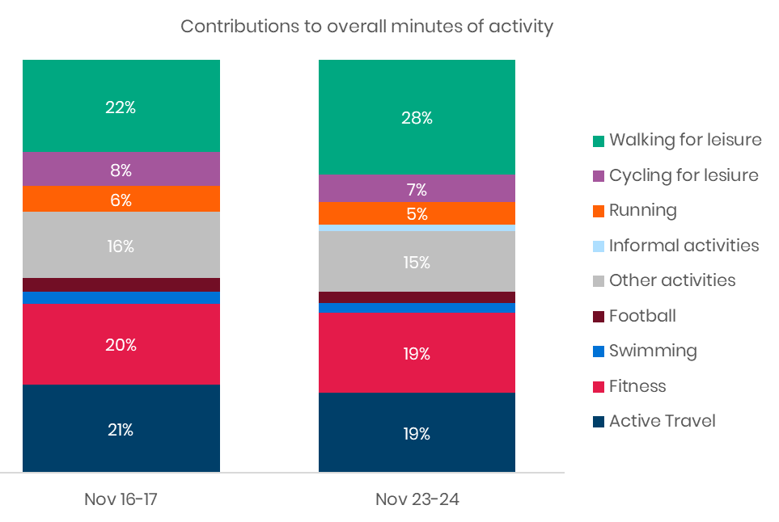
The importance of Active Design and physical activity
Walking, cycling, running and fitness make up 78% of all minutes of activity taken per week.
Opportunity to improve health and wellbeing by increasing physical activity through everyday habits.
Wider benefits of active design:
  Creates environmentally friendly and sustainable places
  Increases social inclusivity
  Increases economic productivity
SAMPLE IMAGE
(Sport England’s Active Lives Survey)
Notes:
Physical activity is more than just traditional sports such as rugby, cricket and football. It also includes everyday activities such as walking, cycling and even climbing the stairs. The graph on this slide presents data taken from Sport England’s Active Lives survey. It shows that these non-sporting activities actually make up 78% of the nation's activity.
These activities are those that can be done in the places around where people live, such as in the street, the park and within the local environment. Active Design can help encourage the design and layout of new and existing communities and neighbourhoods to create the opportunity for people to be active within their local environments. There is a real opportunity to improve health and wellbeing by increasing physical activity through design in everyday habits.
It helps to reduce inequalities associated with accessing opportunities to be active and it also creates more environmentally friendly and sustainable places, increasing social inclusivity and creates more economic productivity.

Slide 6
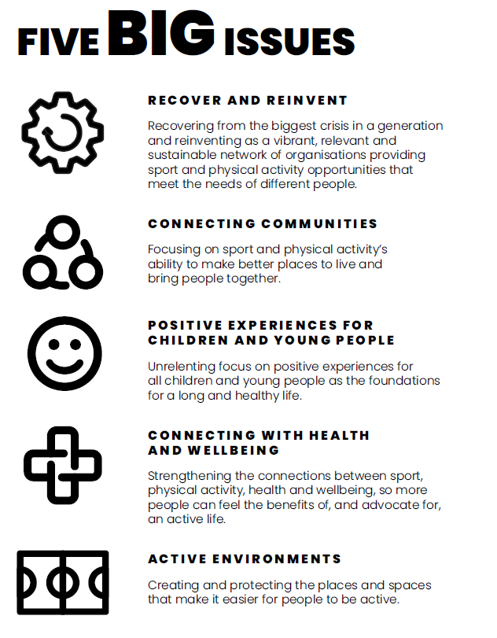

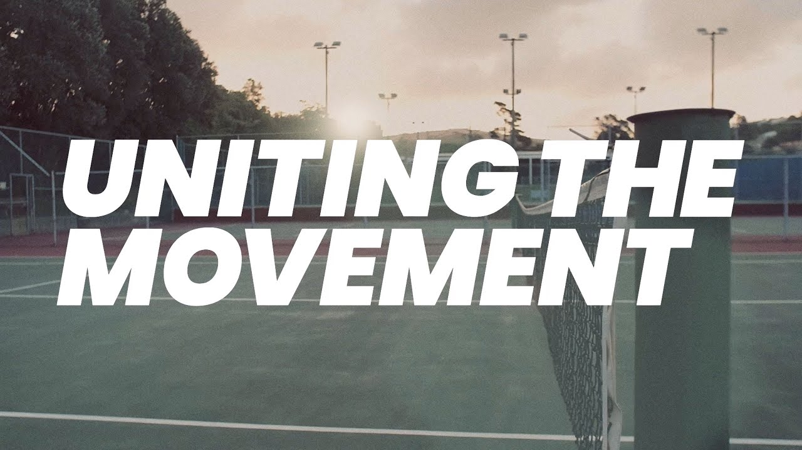
Uniting the Movement Strategy (2021)
Active Environments is one of five big issues that underpin Sport England’s 10-year strategy.
The places and spaces around us can have a positive or negative impact on how, when and where we move.
We want to encourage the design of environments that support and encourage physical activity in our everyday lives.
Notes:
Sport England’s mission is to try and make sport and physical activity a normal part of life for everyone in England.
The built environment plays a vital part in encouraging people to be active, and that’s why Active Environments are one of the five big issues in Sport England’s 10-year Strategy, Uniting the Movement.
As the strategy puts it - There’s no such thing as a ‘neutral space’. The places and spaces around us can have a positive or negative impact on whether, how, when, and where we move

Slide 7
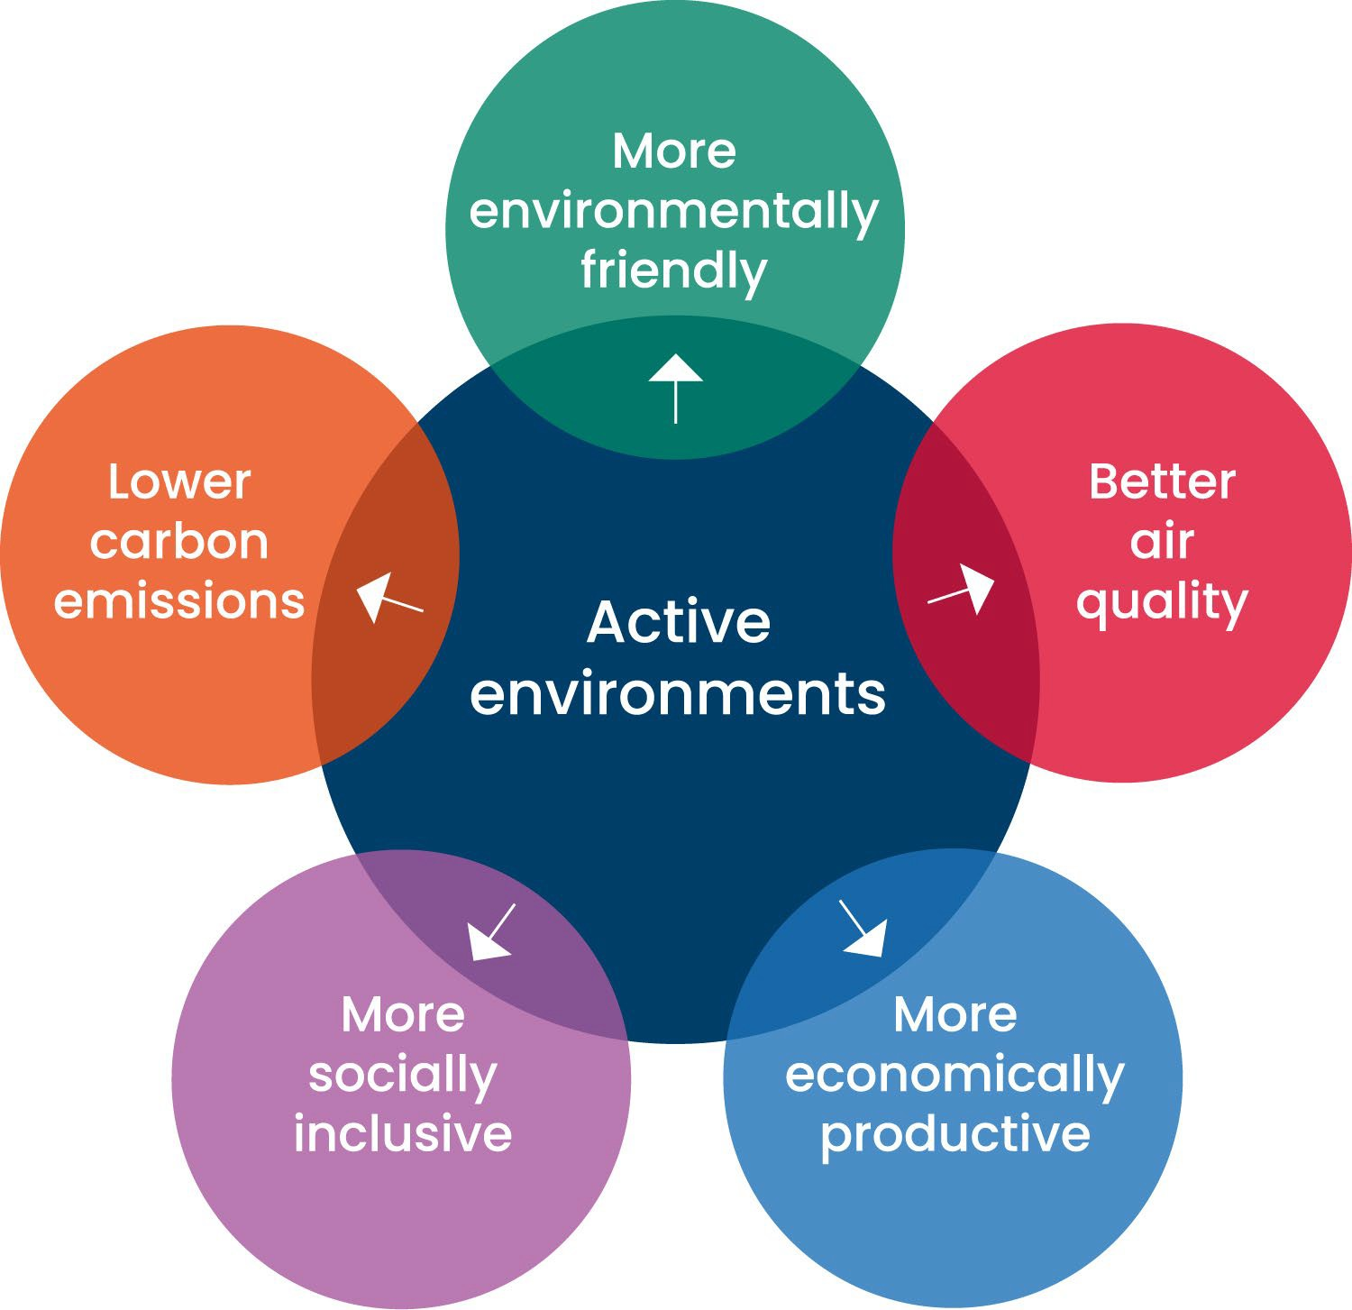
Piggybacking off other priority agendas to drive change in Places
Active Design can complement and assist in the delivery of a number of policy priority areas, fitting into a more joined-up approach to designing the built environment.
Notes:
One of the challenges of delivering Active Design in place is that physical activity and sport per se, is often not high on a local authority’s agenda compared to all the other pressures
Many of the urban design elements of an Active Environment can be interventions that support these other agendas, such as creating green open spaces can help with increasing biodiversity and air quality, or providing connected active travel routes can provide transport options, therefore reducing CO2 emissions.
Active Environments can then support:
Lowering carbon emissions enabling better air quality
Reduce social inequality
Economic productivity
More environmentally friendly spaces
Reduce the cost to health services
Increase biodiversity

Slide 8
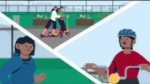
What is Active Design?
Link to video description
Notes:
The following video gives an overview of the topic and is a useful starting point.
Video Length - 3:44

Slide 9
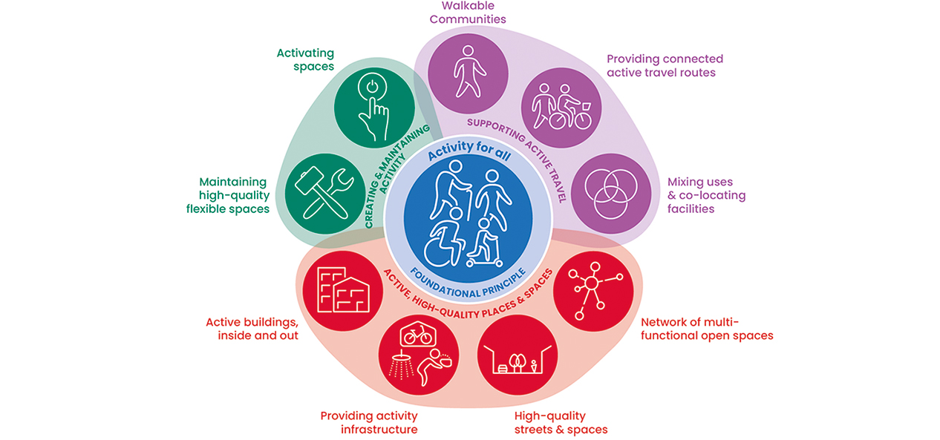
Overall active design themes and principals
Notes:
The diagram on the screen depicts the overall active design themes and principals which are centred by the foundational principal of Activity For All.
At the centre of the diagram the foundational principle ‘activity for all’ underpins all of the principles and then the remaining 9 principles of active design are grouped under three main themes which are:
Theme 1: Supporting Active Travel
Theme 2: Active, High-Quality Places and Spaces
Theme 3: Creating and Maintaining Activity
These can be seen by the three segregating colours on the diagram.
The 10 Active Design Principles are:
Activity for all
Walkable communities
Providing connected active travel routes
Mixing uses and co-locating facilities
Networks of multi-functional open spaces
High quality streets and spaces
Providing activity infrastructure
Active buildings inside and out
Maintaining high quality flexible spaces
Activating spaces

Slide 10

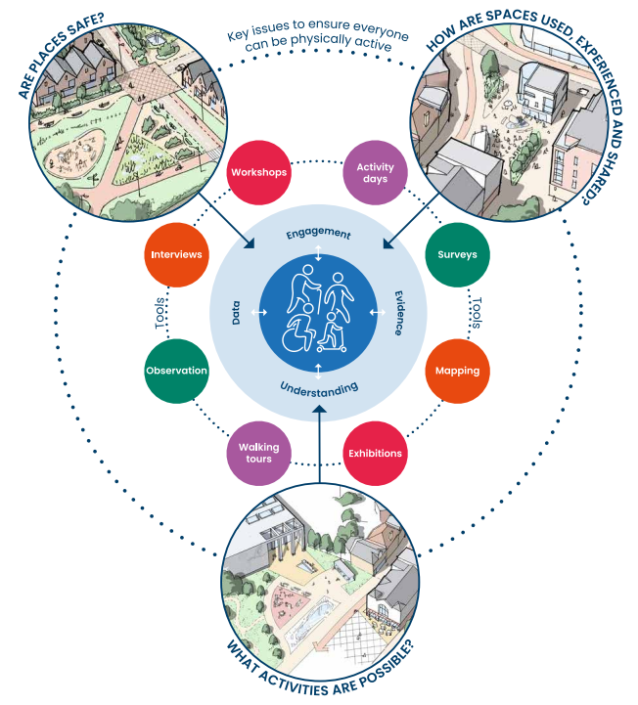
Foundational Principle
Supporting physical activity for all.
Must consider issues that affect physical activity participation.
We must therefore understand the needs of all individuals.
We can do this through an effective consultation process.
Notes:
It is important to note that Principle 1: Activity for All is a foundational principle that is covered in all themes and principles. This principle focuses on understanding different experiences, engaging and listening effectively, and using local data and evidence. Consideration of these features effectively enables opportunities to create safe places, that enable a wide range of activities and facilitate different experiences of using spaces.
The foundational principle of Active Design is to support physical activity for all ages, ethnicities, genders and abilities.
As a collective, we must therefore consider issues that affect physical activity participation. In particular, whether places are safe, whether a wide range of activities can take place and the different experiences of using spaces.
To be able to achieve this, it is important that an exercise of learning and listening is undertaken to properly understand the needs that are sought to be addressed.
To do this, those leading on consultations need to:
Understand different experiences.
Engage and listen actively.
Use local data and evidence.
[NOTE: You can reference back to the ‘Her Barking’ example, which shows how consultation and engagement with specific users can result in a positive solution within the built environment]

Slide 11
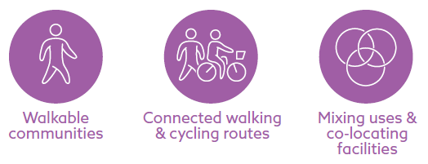
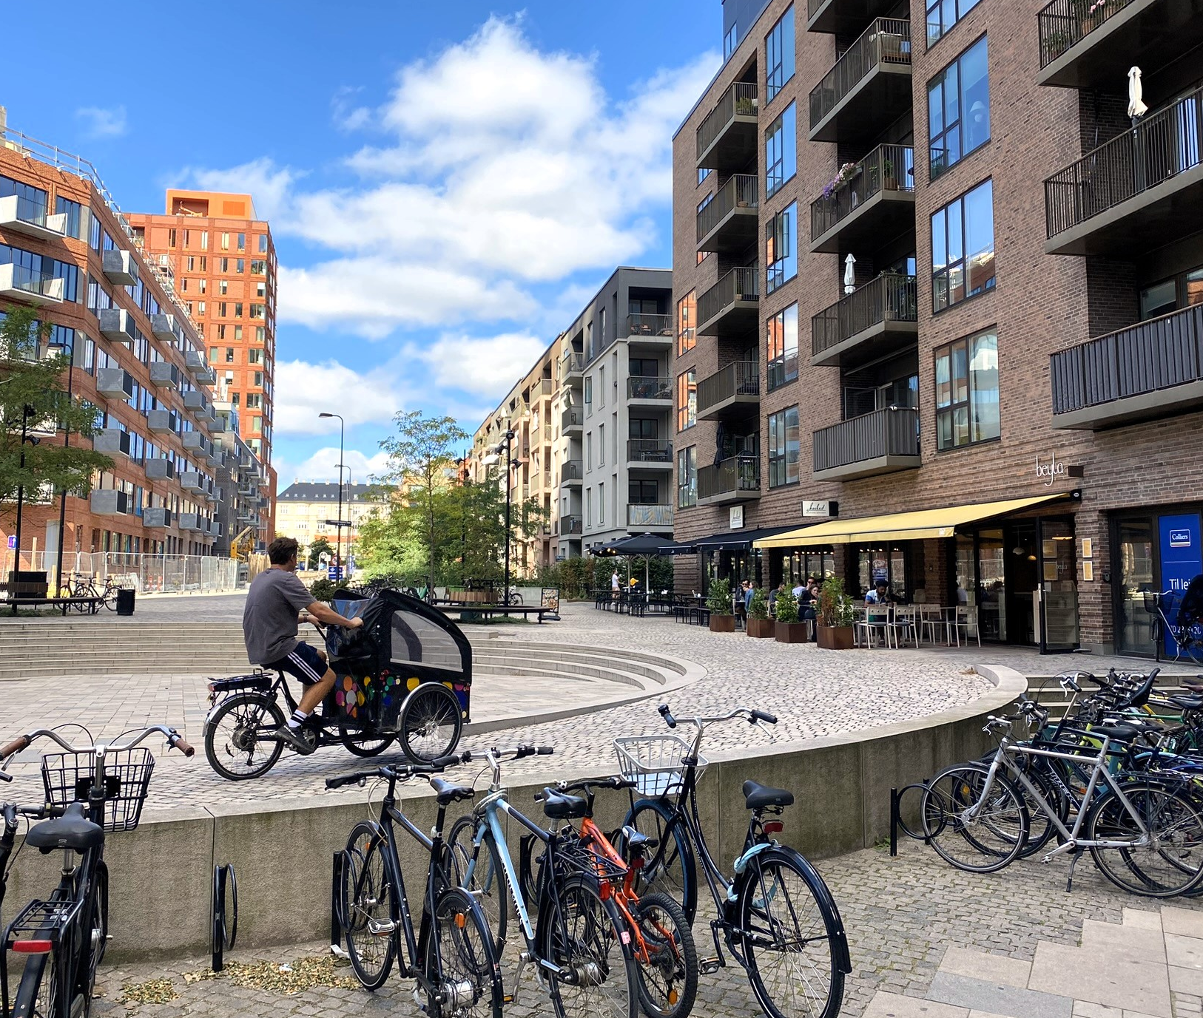
Theme 1: Supporting Active Travel
Compact, walkable, linked communities that are centred around people being active.
All environments should support physical activity for everyone.
People are more likely to combine trips and use active travel where they have multiple reasons to visits.
Image: © Sport England
Notes:
We will first cover theme 1 which is supporting active travel.
The active design guidance advocates for:
Compact, walkable, linked communities that are centred around people being active rather than using cars. This should include environments which support activity for all ages, ethnicities, genders and abilities.
Theme 1 aims to co-locate homes, mixing uses and places for daily essentials and recreation within easy reach by active travel modes known as walkable communities. This means people are fundamentally more likely to make the journey as a pedestrian or by other active travel modes, rather than choosing to get in the car.
To encourage this, developments should promote a hierarchy of travel where pedestrians, cyclists and other active travel users are considered first.
Active travel networks should form a continuous and connected grid in a development, whereas private vehicle movement should be less direct and longer. Bus routes should be direct and uninterrupted to support active travel networks by providing onward connections. Making walking, cycling and public transport networks more permeable than the road network is called “filtered permeability”. An example of this is how vehicular traffic can be filtered through the use of bollards and planters.
The guidance discusses that people are more likely to combine trips and use active travel to get to destinations with multiple reasons to visit. Places with more variety and higher densities and a mix of uses also reduce the perception of distance when travelling through spaces and generate the travel demand to better support public transport services.
Places with more active travel and public transport connections should therefore have more facilities, uses and higher densities to make them as accessible as possible to the most people.

Slide 12
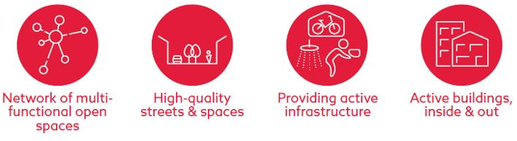
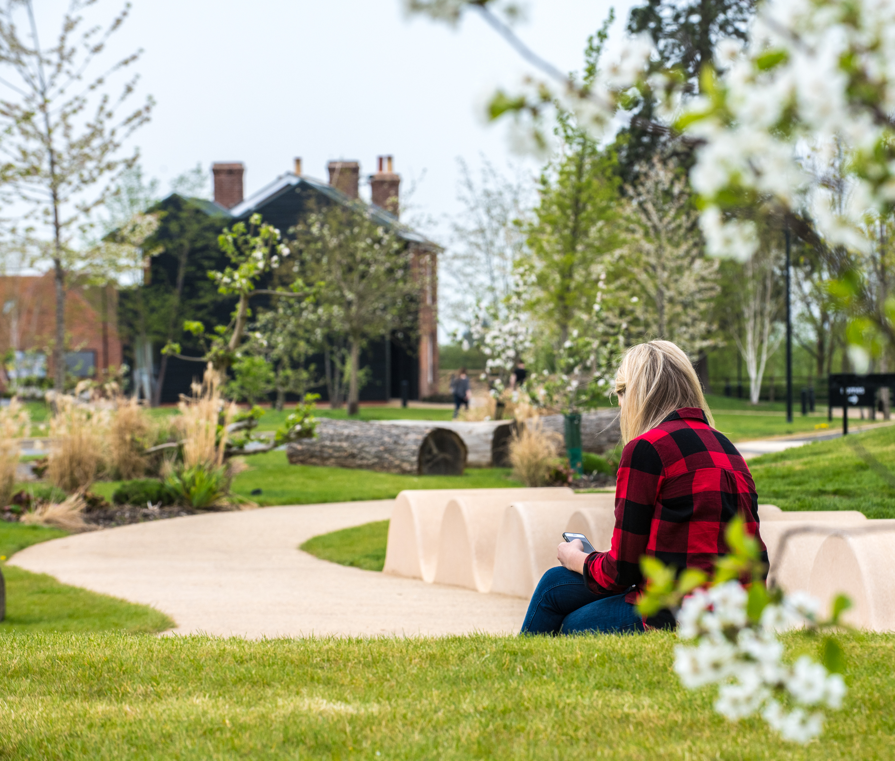
Theme 2: High-Quality Active Places
Ensuring a space is safe and feels safe is an essential part of securing design quality
Active routes which are attractive will be used by more people
Streets and places are not simply movement corridors
Image: © Urban & Civic
Notes:
Theme 2 covers an active and high-quality built environment.
This theme discusses how safe our built environment is, which is fundamental to enabling different groups of people to use them.
We live in a diverse society and every group has different life experiences, which may include perceptions of safety. Active Design advocates for equity of physical activity in the built environment.
With the greater number of pedestrians on the street, the presumption of safety increases. Active and walkable routes which are attractive will encourage more people to use them.
As such, streets and public spaces of all types should be high-quality and designed to be attractive places and not simply movement corridors.
Providing multi-functional spaces allows for sport and physical activity to be delivered alongside other priorities such as biodiversity, community space, sustainability or other needs.
The theme also covers more detail on providing activity infrastructure and creating active buildings inside and out . There are lots of opportunities to encourage activity through a well-designed arrival experience and corridor network that encourages pedestrian movement, for example making the stairs the most convenient way to access a building, or introduce supporting equipment that encourages activity, such as cycle storage, showers and maintenance hubs, and informal sporting equipment such as table tennis tables.

Slide 13
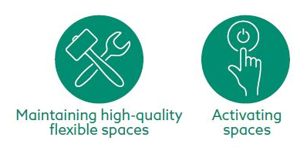
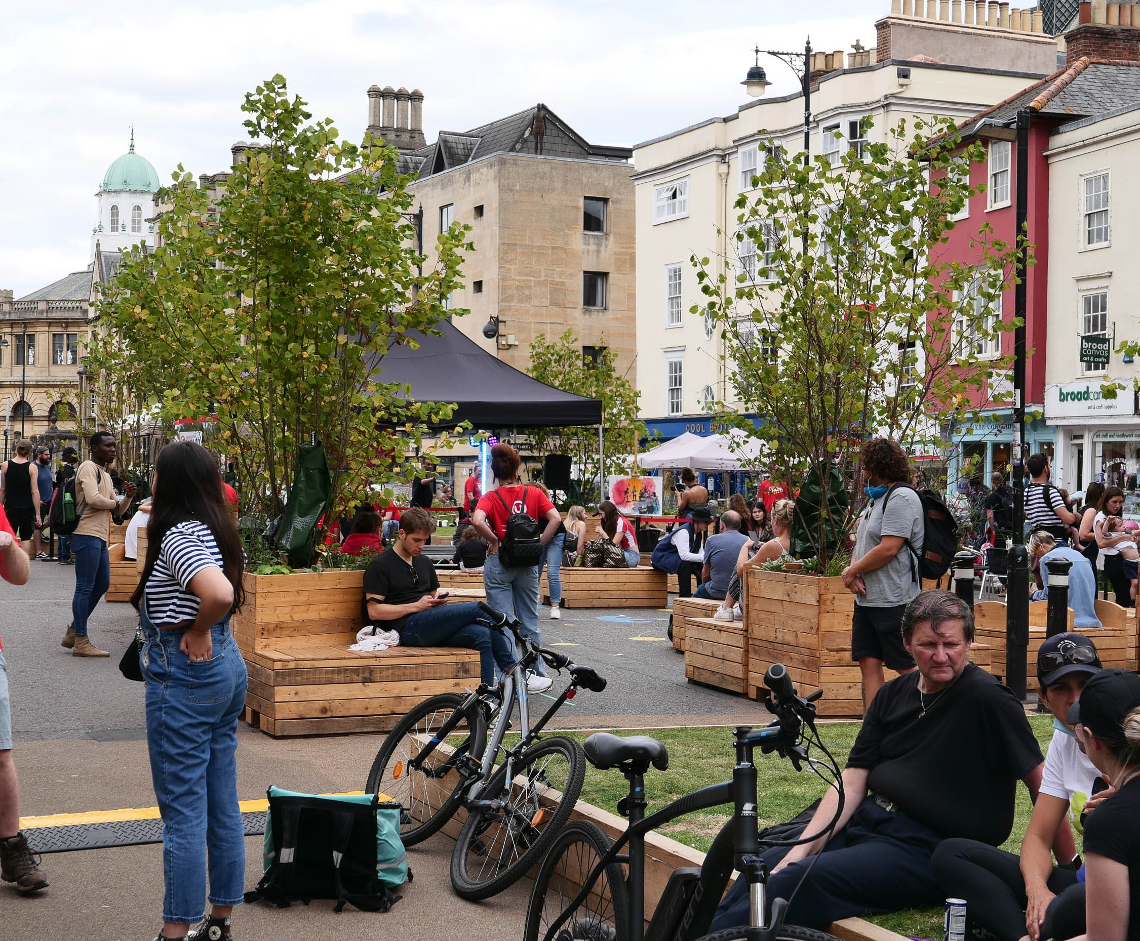
Theme 3: Creating & Maintaining Activity
Spaces and facilities should be effectively maintained and managed
Multi-functional spaces allow for physical activity to be delivered alongside other priorities
High-quality, flexible spaces are those that can be adapted easily
Image: © David Lock Associates
Notes:
Spaces and facilities should be effectively maintained and managed to support physical activity. These places should be monitored to understand how they are used and how flexible they are so that they can be adapted as needed.
Theme 3 also advocates that as the population ages, it is crucial that buildings are adaptable for lifetime use and changing requirements. This provides opportunities for many different groups to be physically active.
The monitoring and evaluation of physical activity interventions is important to understand what is effective and what is less so.
A key part of this theme is activating spaces which focuses on the communication, promotion and support for active spaces. Supporting volunteers and local champions within communities is vital as they can effectively communicate opportunities for activities. Promotion requires effective investment to unlock activity infrastructure.

Slide 14
Optional short summary quiz
According to the Chief Medical Officer, what is the recommended minimum number of minutes the average adult should exercise per week?
How many active design themes are there?
What is the foundational principle for the active design guidance?
Providing active travel routes To decrease foot traffic
Creating active, high-quality spaces and places
Activity for All
30 minutes
90 minutes
120 minutes
150 minutes
10
5
3
4

Slide 15
Answers
According to the Chief Medical Officer, what is the recommended minimum number of minutes the average adult should exercise per week?
How many active design themes are there?
What is the foundational principle for the active design guidance?
Providing active travel routes To decrease foot traffic
Creating active, high-quality spaces and places
Activity for All
30 minutes
90 minutes
120 minutes
150 minutes
10
5
3
4
Notes:
Optional short quiz.
Correct answers are as follows:
D - CMO recommends that adult should reach 150 minutes -
C
C

